Slide 1
No case for case (and gender) in Stamford Hill Hasidic Yiddish
Zoë Belk
Lily Kahn &
Kriszta Eszter Szendrői
Department of Linguistics & Department of Hebrew & Jewish Studies
YilaS2, Düsseldorf, 11-14 June 2019
Notes:
Emetser hot gezugt a mul az es iz shtendik beser tsi haltn a referat vegn yidish oyf yidish, afile oyb de yidish iz a tsibrokhene. Ma:n yidish iz a gelernte yidish. Es iz nisht fin de haym.
Inzere referat iz vegn vus mentshn rifn hasidishe yidish, oder geredte yidish. Vus dov ber-kerler hot gerifn haymishe yidish. Ints hobn gemaynt az es iz efsher nokh mer vikhtik tsi haltn a referat vegn dem oyf yidish, hasidishe oder klal, vus me redt gevenlekh.

Slide 2
Introduction
vast majority of current day Yiddish speakers are Haredi
most Yiddish-speaking Haredi Jews are Hasidic (Isaacs 1999: 12)
currently an estimated 750,000 Hasidic Jews globally (Biale et al. 2017)
largest communities in Israel (Meah Shearim, Bnei Brak); the US (Boro Park area); in Antwerp, Belgium; and in London’s Stamford Hill (ca. 40,000 people)
in SH, over 75% of adults and children are ‘fluent’ in Yiddish, and over 50% use it as ‘the main language at home’ (Holman & Holman 2002) (see Isaacs (1999:13) for similar claims about the other communities)
linguistic research on Hasidic Yiddish is scarce, and for Stamford Hill Hasidic Yiddish practically non-existent (pace Mitchell (2006), a sociocultural study)
Notes:
Haynt tsu tog ken meg zugn az de rov mentshn vus redn yidish zenen haredi, mestens hasidish. Es zenen du be’erekh zibnhindertfiftsiktoyzend hasidishe jidn. Zay voynen in etlekhe erter in erets yisruel, in amerike, in begiye in antverpen in oykh in England in de Stamford hill geygnt fin londen. Loyt de sotsiale forshung fun holman un holman, redn finfinzibtsik protsent fin ervaksener in kinder yidish. Be’erekh a helft fin mentshn redn yidish tsvishn zikh in der haym tog teglekh. Es zenen nisht kayn sakh forshungen vegn yidish in Stamford hill, in kal vahoymer nisht lingvistishe forshungen.

Slide 3
Our claim
in contrast to Standard Yiddish and pre-War spoken dialects, contemporary SHH has no case or gender on nominals
other Hasidic communities seem to have also lost case and gender, but we have no systematic data
many have noted (advanced) morphological syncretism in the case and gender paradigms (Krogh (2012), Assouline (2014), Sadock & Masor (2018))
we argue for full loss of the notion of case and gender in the mental grammar of contemporary SHH Yiddish speakers
this is rapid and pervasive language change: the linguistic character of the language is altered (cf. Middle vs. Modern English, where the same change happened over 400 years)
Notes:
De iker fin indzere referat iz az de yidish fin Stamford hil, in efsher hasidishe yidish mer in algemeyn, iz andersh fin klal yidish in oykh andersh fin di dialektn fin yidish far de milhome az es iz nitshto kayn beygfal oder min in hayntike geredte oder hasidish yidish. Andere forshers hobn shoyn bamerkt morfologishe sinkretizmen in beygfaln in min, ober ints taynen az der bagrif fin beygfaln in gramatishe min iz neylm gevoyrn fin zayer gramatishe farshteyndenish. Oyb ints zenen gerekht, iz dus a gikhe in arimnemike lingvistishe farenderung, vus hot gebayt di lingvistishe teyve finem shprakh. Yetst iz geredte yidish mer azoy vi hayntige English, bshas klal yidish iz mer azoy vi Mitl-English in Alte English iz a mul geven. Ober me darft zikh nisht metsayer zayn, az epes iz farloyrn gevorn, az Moderne English iz o:kh a sprakh.

Slide 4
Standard Yiddish case and gender
DAT | ACC | NOM
דעם גוטן dem gutn |  | דער גוטער der guter ‘good’ | MASC
דער גוטער der guter | די גוטע di gute |  | FEM
(אַ) גוט (a) gut |  |  | NEUT (indefinite)
דעם גוטן dem gutn | דאָס גוטע dos gute |  | NEUT (definite)
די גוטע di gute |  |  | PL
Notes:
Lomir zikh dermonen fin di baygfaln in gramatishe min tsaykhns in di aynshtimung fin di attributi:ve adyekti:vn. Ober enk ale vaysn vi es zet oys af klal yidish.

Slide 5
Elicited data – background information
12 native Yiddish speakers born and raised in Stamford Hill
other Hasidic communities seem to have also lost case and gender, but we have no systematic data
3 male, 9 female
age range: 20-70+, mostly 20s
Hasidus: Satmar, Vizhnitz, Belz, Bobov, Slonim
geographical origin: GP generation Hungary, Poland, Vienna, France, Israel, Iraq, UK
tasks
other Hasidic communities seem to have also lost case and gender, but we have no systematic data
online translation task
Pictionary writing task: 8 singular 3 plural nouns in three genders (Swadesh list and frequent nouns)
dictation task: same 33 nouns with modifying adjectives in all 3 cases
copy editing task: excerpt from Tribune doctored with case/gender omission and commission errors and typos
judgment task: same 33 nouns provided with all 4 determiners in subject, object and P-object positions
Notes:
Lomir onheybn mit a bisele informatsye vegn indzeer forshungen. Indzere onternemers zenen geven tsvelef yidish-reders vus zenen geboyrn gevorn in Stamford hill in gevaksn gevorn dortn. Nayn fin di mentshn zenen geven vayber, dray mener. Mestens fin di mentshn zenen bay de tsvantsiker. Zay gehern tsi varshidene hasidesn. Di eltern fin inzere onternemers zenen geboyrn gevorn mestens in England oder amerike, ober di bube zaydes zenen gekimen fin farshidene erter, lemoshl ingarn, poyln, estraykh, in azoy vayter.
Inzere genitungen zenen geven azoy. Di ershte gentigung iz geven a shtikl tekst vos me hot gebetn mentshn zay zoln es iberzetsn fin English af yidish. Bay di tsvayte genitung mentshn hobn geshriben di nomen fin etlekhe bilder, dernokh hobn zay geshribn zatsn vos zay hobn gehert af hasidish yidish. Dernokh hobn zay bekimen a klayn shtikl tekst tsi kontrolirn far tausim, in tsum sof hobn zay geleyent ale meglikhe zatsn in zay hobn gedarft oysklaybn di rikhtige verzye.

Slide 6
Published material – background information
Tribune corpus
other Hasidic communities seem to have also lost case and gender, but we have no systematic data
5 articles from the Yiddish section of the Stamford Hill weekly Hasidic newspaper
Varshever corpus (Geller 2001)
other Hasidic communities seem to have also lost case and gender, but we have no systematic data
comparable section of the spoken interviews with pre-War Warsaw speakers
Reb Nahman’s tales
other Hasidic communities seem to have also lost case and gender, but we have no systematic data
Tales 1, 2, 3 and 9 out of 13 tales
recordings of Hasidic rebbes
other Hasidic communities seem to have also lost case and gender, but we have no systematic data
15-minute excerpts from droshes of Naftali Tsvi Halberstam (b. 1931, Bobover rebbe), Y. Y. Halberstam (b. 1905, Sanz-Klausenburger rebbe), Joel Teitelbaum (b. 1887, Satmar rebbe)
other Hasidic communities seem to have also lost
Notes:
Indzere gedrikte materialen zenen geven a heyfele artiklen af yidish fin di tsaytung vus hayst Tribune, vus vert gedrikt in londen. A shtikl tekst fin geredte interviewen mit yidish-reders vos zenen geboyrn gevorn in varshe, far de milhome. A pur fin reb nahman’s mayses, in mit arum a sho fun rekordirungen fin droshes fin hasidishe rebes vos zenen geboyrn gevorn far de milkhome.

Slide 7
Overview
gender
other Hasidic communities seem to have also lost case and gender, but we have no systematic data
historical comparison data: Hasidic written & spoken sources; Varshever corpus (Geller 2001)
elicited data: spoken & written
published written data
case
other Hasidic communities seem to have also lost case and gender, but we have no systematic data
historical comparison data
elicited data: spoken and written
published written data
conclusions & outlook
Notes:
De plan fin de referat iz az lily kahn vet ints dertseyln vegn min. Zi vet onheybn mit indzere rezultatn vegn historishe geredte in geshribene materialn. Dernokh kimen oysgefregte geredte in geshribene datn in dernokh vet zi dertseyln vegn gedrikte geshribene materialn. Dernokh vet zoe belk dertseyln ints vegn indzere rezultatn vegn baygfaln. Vi azoy frier, ersht me vet hern vegn hisorishe materialn, dernokh oysgefregte geredte in geshribene zakhn, in tsum sof vegn gedrikte geshribene materialn. Tsim same sof vel ikh makhn a sakhakl.

Slide 8
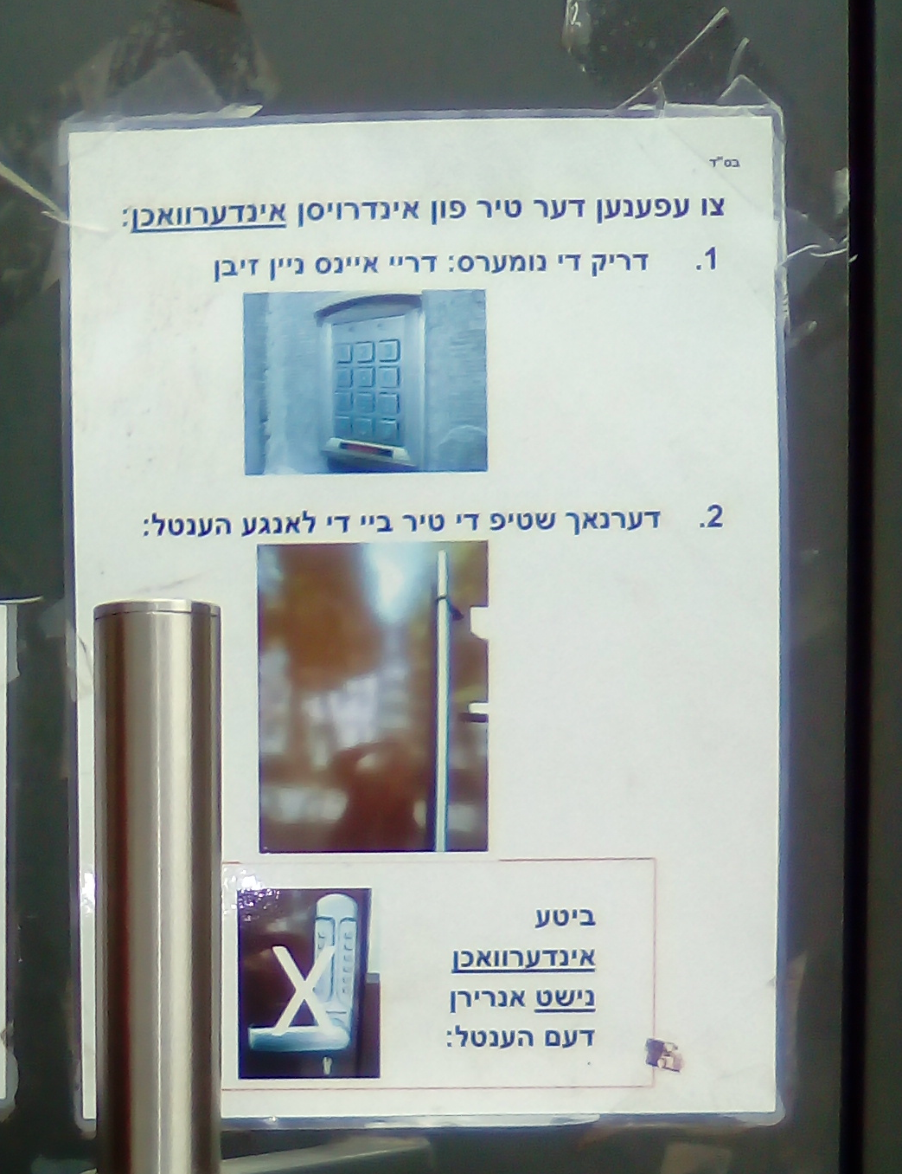
Gender — key findings
consistent gender marking in historical written and spoken data
no gender marking in spoken data
inconsistent gender marking in elicited and published written data

Slide 9
Historical comparison data – key findings
data: Hasidic written and spoken sources from pre-War speakers (R. Nahman, Hasidic rebbes, Hasidic badkhn)
nominal gender agreement fully corresponds to the Standard Yiddish and traditional Mid-Eastern and South-Eastern dialect paradigms
masculine, feminine, and neuter genders
this holds for written and formal spoken data
→ more live spoken pre-War data being collected
other Hasidic communities seem to have also lost case and gender, but we have no systema

Slide 10
Historical comparison data – Varshever corpus (Geller 2001)
other Hasidic communities seem to have also lost case and gender, but we have no systema
 | דער | די | דאס | דעם
MASC (total: 96) | 96% | 0% | 0% | 0%
FEM (total: 86) | 4% | 100% | 0% | 0%
NEUT (total: 41) | 0% | 0% | 100% | 0%
Total rate of gender errors 2.3%
Represents two/three speakers; consistent strategy (using prescriptively correct gender!)
Existence of neuter gender (11 tokens/44)

Slide 11
Elicited spoken data: no gender marking on determiners or adjectives
NOM | 1a. | MASCULINE də ureme man the poor man |  | b. | FEMININE də alte fro: the old woman |  | c. | NEUTER də alte purfolk the old couple
ACC | 2a. | də ureme mentsh the poor person |  | b. | a gite besiə good news |  | c. | də beste flaysh the best meat
DAT | 3a. | mit də ziste tsimes with the sweetest tsimes |  | b. | af də tserisenə shvartse kapote at the torn black kapote |  | c. | mit a brayte ofene harts with a wide open heart

Slide 12
Elicited spoken data: attributive marking
1 | də houz iz groys/*groysə. the house is big/big-e ‘The house is big.’
2 | frayhayt iz vikhtik/*vikhtikə. freedom is important/important-e ‘Freedom is important.’
3 | ints hobn gefarbt də tir royt/*royte. we have painted the door red/red-e ‘We painted the door red.’

Slide 13
Elicited written data: methods
PICTIONARY TASK
Write name of picture into schema: __________ _______ד
Should give us gender of nouns, in principle
12 imageable nouns in MASC, FEM, 8 in NEUT
about half from Swadesh list, half very frequent nouns, some Hebrew origin words

Slide 14
Elicited written data – results
 | דער | די | דאס | דעם
MASC (total: 96) | 61.5% | 24% | 1% | 13.5%
FEM (total: 86) | 65% | 30% | 0 | 4.5%
NEUT (total: 41) | 46.5% | 24.5% | 10% | 19.5%
other Hasidic communities seem to have also lost case and gender, but we have no systema
total rate of gender errors is 50.5%
individual strategies vary widely and sometimes change from page to
page within an individual
-דער across-the-board (sometimes even with plurals)
-די across-the-board
-דעם and דער used more or less randomly
- random mix of דעם, דאס, די, דער
our 70+ participant, incomplete data: 100% (5) M דער; 80% (5) F די; 0% (1) N דאס

Slide 15
Published written (Tribune) data: inconsistent gender marking
total number of gender-marked NPs in corpus 148, of which 133 have a set gender in Standard Yiddish (i.e. not English borrowings)
altogether 98 different nouns occurred
only two items occurred with דאס, most nouns appear to be used as masculine or feminine
total rate of gender errors is 22%

Slide 16
Published written (Tribune) data: inconsistent gender marking
NOMINATIVE | דער/ דעם | די | דאס
MASCULINE (total: 19) | 89.5% | 10.5% | 0%
FEMININE (total: 11) | 27.5% | 63.5% | 9%
NEUTER (total: 2) | 0 | 50% | 50%
MASC standard forms are boosted by a very high number of דער forms overall, which happen to correspond to standard gender in the NOM.MASC.
practically no NEUT examples in the NOM, but other cases show lack of use of דאס
many commission errors do not reflect a consistent gender assignment that is different from the standard, as gender assignment is variable even for the same nouns

Slide 17
Published written data: breakdown of findings
Tribune corpus |  | (%ages calculated over identifiable gender only)
 | der.Nom | dem.Nom | di.Nom | dos.Nom
MASCULINE | 84% | 1 (100%) | 2 (20%) | 0
of which animates | 10 | 0 | 1 | 0
FEMININE | 16% | 0 | 7 (70%) | 1 (50%)
of which animates | 1 | 0 | 2 | 0
NEUTRAL | 0 | 0 | 1 (10%) | 1 (50%)
of which animates | 0 | 0 | 0 | 0
indeterminate | 0 | 0 | 2 | 0

Slide 18
Published written data: breakdown of findings
Tribune corpus |  | (%ages calculated over identifiable gender only)
 | der.Nom | dem.Nom | di.Nom | dos.Nom
MASCULINE | 16 (84%) | 1 (100%) | 2 (20%) | 0
of which animates | 10 | 0 | 1 | 0
FEMININE | 3 (16%) | 0 | 7 (70%) | 1 (50%)
of which animates | 1 | 0 | 2 | 0
NEUTRAL | 0 | 0 | 1 (10%) | 1 (50%)
of which animates | 0 | 0 | 0 | 0
indeterminate | 0 | 0 | 2 | 0
dem.Acc | di.Acc | dos.Acc | der.Acc | dem.Prep | der.Prep | di.Prep | dos.Prep
6 (67%) | 6 (40%) | 0 | 2 (100%) | 20 (77%) | 3 (38%) | 5 (14%) | 0
1 | 0 | 0 | 2 | 4 | 1 | 0 | 0
2 (22%) | 7 (47%) | 0 | 0 | 1 (4%) | 5 (63%) | 30 (81%) | 0
0 | 0 | 0 | 0 | 0 | 0 | 0 | 0
1 (11%) | 2 (13%) | 1 (100%) | 0 | 5 (19%) | 0 | 2 (5%) | 3 (100%)
0 | 0 | 1 | 0 | 0 | 0 | 0 | 1
1 | 1 | 0 | 0 | 4 | 1 | 6 | 0

Slide 19
Gender: summary
 | Gender error rate
elicited spoken data | 100%
elicited written data | 50.5%
published written data (Tribune corpus) | 22%
Varshever corpus | 2.3%
historical Hasidic data (R. Nahman, rebbes) | 0%
‘Oh, but Yiddish is not like French or Hebrew, it does not have masculine and feminine!’
‘der, di, de – no idea..’
‘- Upon reflection you would write di car and dos tish. - Not der tish? - Hmm, both sound right.'
‘דער should be used for bigger objects, while דאס should be used for smaller objects, e.g. דער בוים, דאס בלום’ (school textbook, Hotsa’at Chay 1999: 33)

Slide 20
Case – key findings
consistent case marking in historical written and spoken data
no case marking in spoken data
inconsistent case marking in elicited and published written data

Slide 21
Historical comparison data – key findings
data: Hasidic written and spoken sources from pre-War speakers (R. Nahman, Hasidic rebbes, Hasidic badkhn)
case fully corresponds to the Standard Yiddish and traditional Mid-Eastern and South-Eastern dialect paradigms
nominative, accusative, and dative cases in all three genders
this holds for written and formal spoken data
→ more live spoken pre-War data being collected

Slide 22
Historical data – Varshever corpus
Varshever corpus |  | (%ages calculated over identifiable gender only)
 | der.Nom | dem.Nom | di.Nom | dos.Nom
MASCULINE | 23 (96%) | 0 | 0 | 0
of which animates | 22 | 0 | 0 | 0
FEMININE | 1 (4%) | 0 | 9 (100%) | 0
of which animates | 1 | 0 | 3 | 0
NEUTRAL | 0 | 0 | 0 | 11(100%)
of which animates | 0 | 0 | 0 | 3
indeterminate | 0 | 0 | 0 | 0
dem.Acc | di.Acc | dos.Acc | der.Acc | dem.Prep | der.Prep | di.Prep | dos.Prep
3 (100%) | 0 | 0 | 0 | 19 (58%) | 0 | 2 (8%) | 0
0 | 0 | 0 | 0 | 6 | 0 | 0 | 0
0 | 10 (100%) | 0 | 0 | 0 | 6 (100%) | 21 (84%) | 0
0 | 0 | 0 | 0 | 0 | 1 | 5 | 0
0 | 0 | 1 (100%) | 0 | 14 (42%) | 0 | 2 (8%) | 0
0 | 0 | 1 | 0 | 4 | 0 | 0 | 0
0 | 0 | 1 | 0 | 2 | 1 | 6 | 0

Slide 23
Historical – Varshever corpus
clear gender and case system, roughly in line with Standard Yiddish and traditional Mid-Eastern and South-Eastern dialect paradigms
feminine dative usually realized as PREP+di, although PREP+der also attested
2/2 intimate nouns appear with ACC/DAT ending; 0/2 appear in Tribune corpus
0/21 mismatched case/gender endings; 5/32 (15%) in Tribune corpus

Slide 24
Elicited spoken data: no case marking on determiners or adjectives
NOM | 1a. | MASCULINE də ureme man the poor man |  | b. | FEMININE də alte fro: the old woman |  | c. | NEUTER də alte purfolk the old couple
ACC | 2a. | də ureme mentsh the poor person |  | b. | a gite besiə good news |  | c. | də beste flaysh the best meat
DAT | 3a. | mit də ziste tsimes with the sweetest tsimes |  | b. | af də tserisenə shvartse kapote at the torn black kapote |  | c. | mit a brayte ofene harts with a wide open heart

Slide 25
Elicited written data: dictation task
Nº = 346 | standard case marking | standard case, nonstandard gender | standard gender, nonstandard case | nonstandard case, nonstandard gender | Ungrammatical form in standard
mean | 22% | 34.5% | 11% | 17.5% | 15%
range | 17%-34% | 2.5% - 54% | 7.5% - 13% | 0% - 32% | 0% - 68%
individual strategies again vary widely:
PART_1: only די -ע forms → 32% standard, 0% ungrammatical
PART_2: mostly דער (-ע) forms → 34% standard, 7% ungrammatical
28 forms expected overall, 60 forms found including דער -ע forms in all cases;
דעם –ע forms in all cases, including NOM;
11 of 18 plural forms were standard די -ע, but 7 out of 18 (39%) occurred with f
forms ungrammatical in the standard, mostly דער -ע, but some דעם -ע.
only 2 instances of matched agreement of the דער -ער only 1 of which is F.DAT.
no דעם -ן forms used at all.

Slide 26
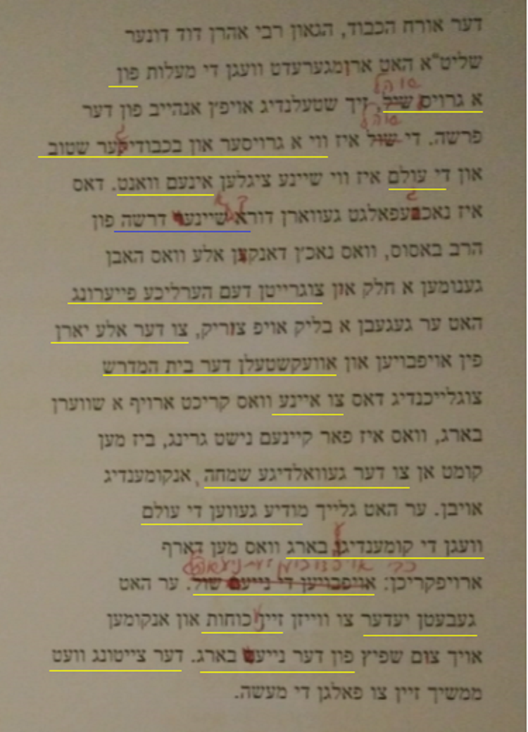
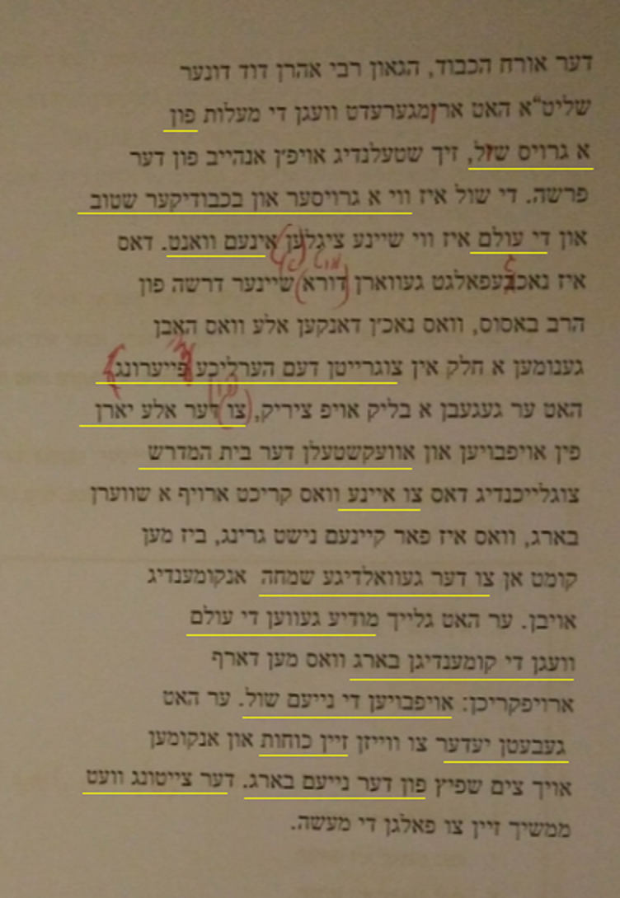
Elicited written data: copy editing task
Adapted from article in the Yiddish Tribune, 9 March 2017

Slide 27
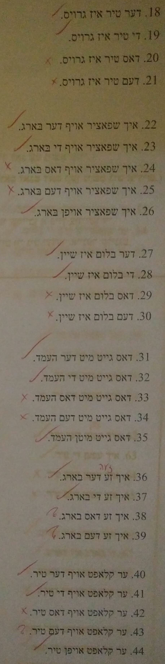
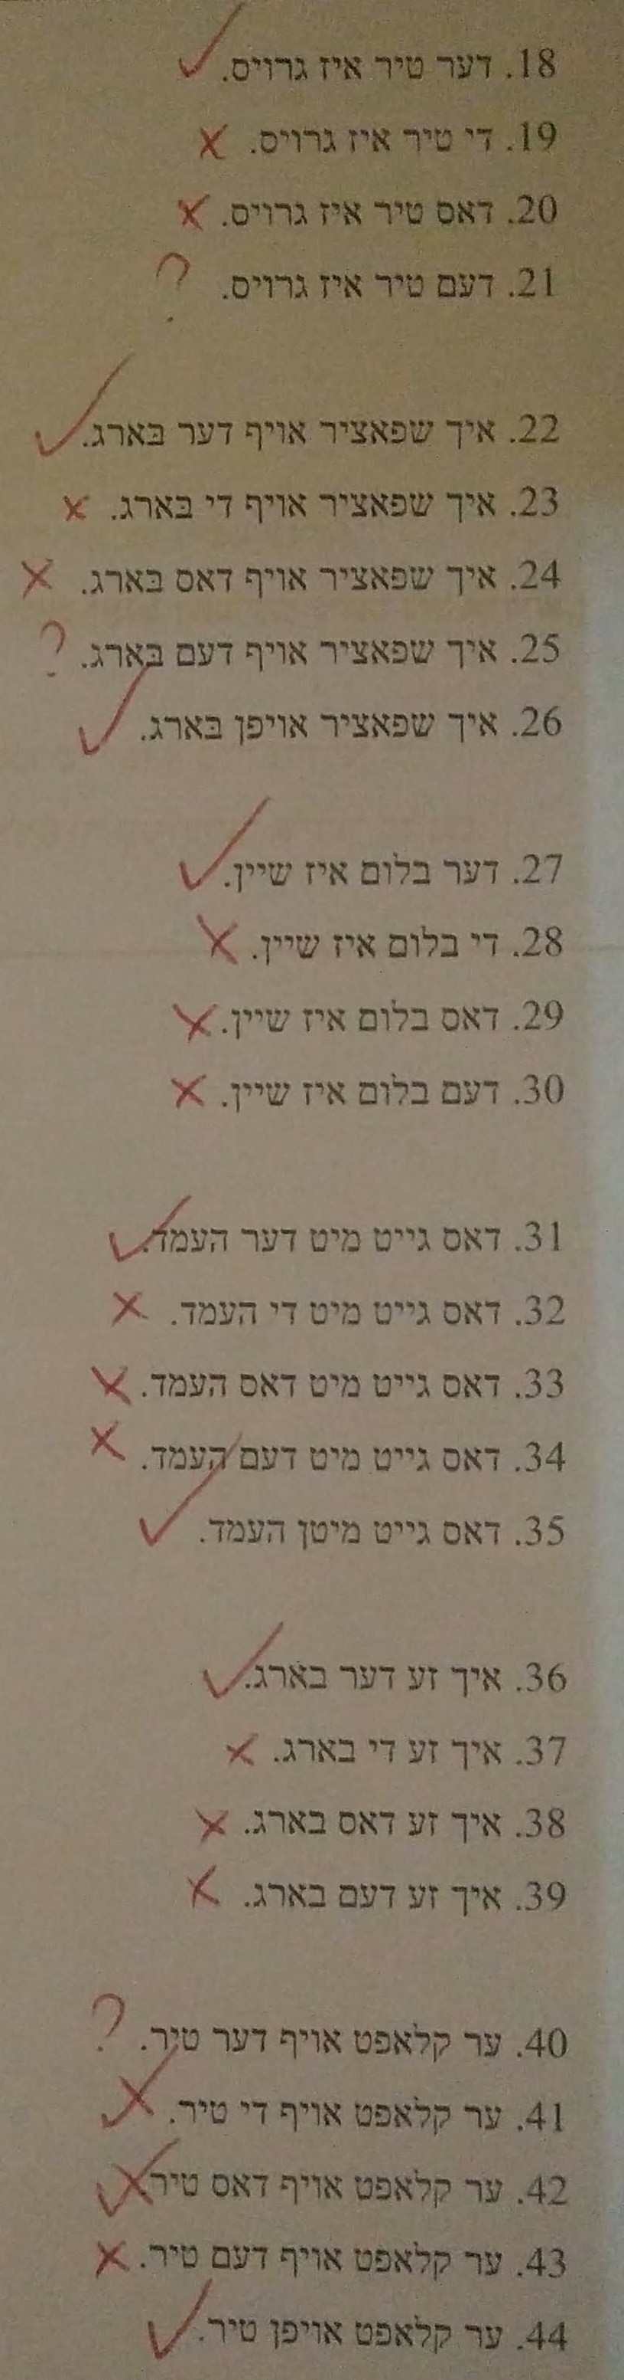
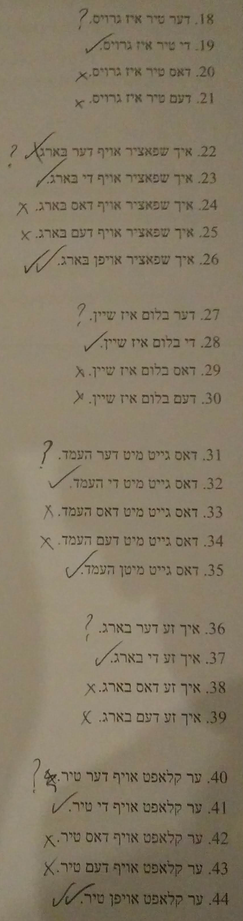
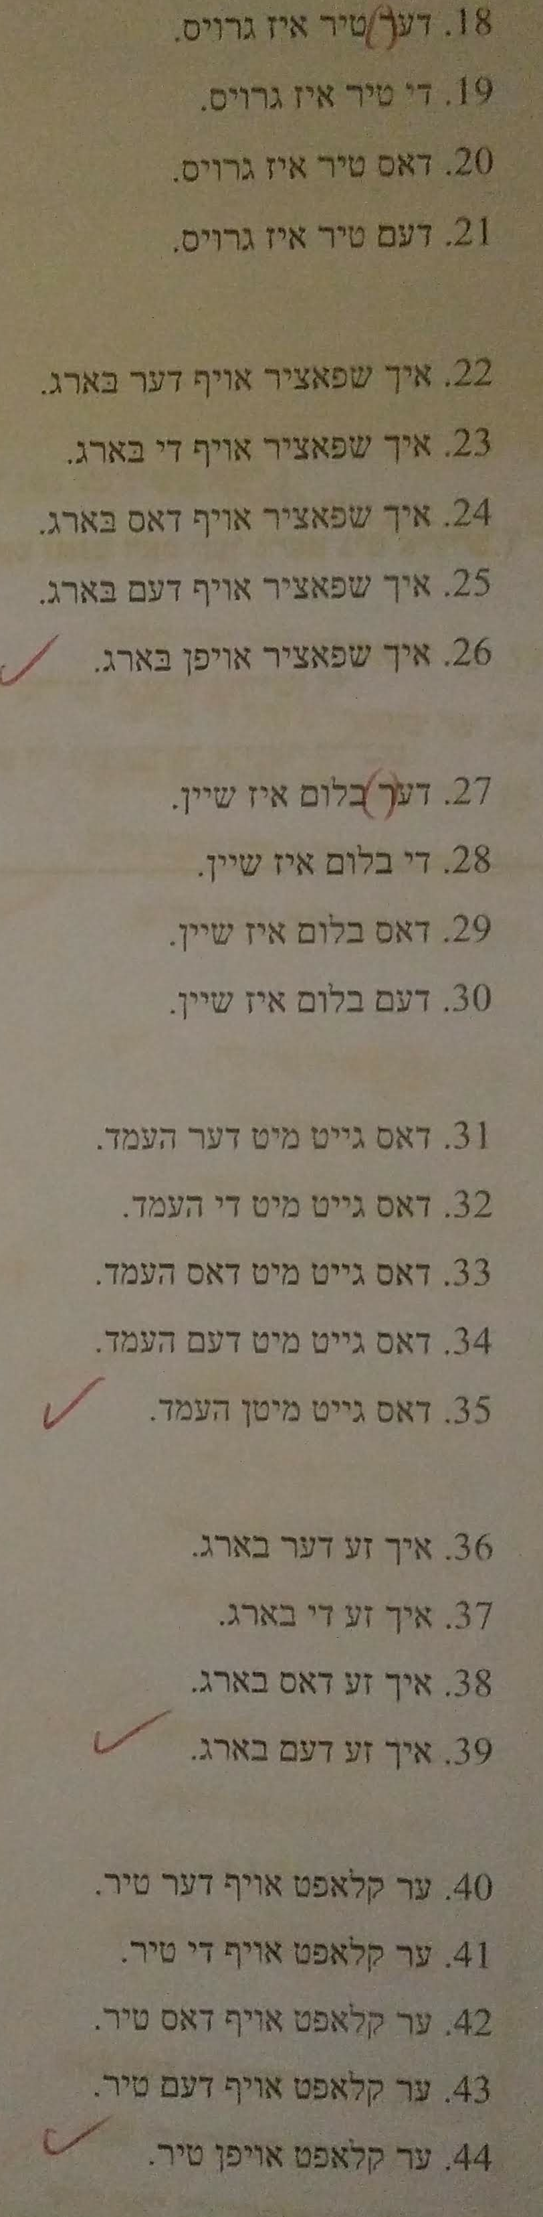
Elicited written data: judgment task
✓
✓
✓
✓
✓
✓
✓
✓
✓
✓
✓
✓
✓
✓
✓
✓
✓
✓
✓
✓
✓
✓
✓
✓
✓
✓
✓
✓
✓
✓
✓
✓

Slide 28
Published written (Tribune) data: inconsistent case marking
all genders | standard case | possible gender variant | other
MASCULINE (total: 61) | 69% | 18% | 13%
FEMININE (total: 56) | 34% | 12.5% | 53.5%
NEUTER (total: 16) | 44% | 25% | 31.5%
“other” forms include NOM דעם, ACC דער, P+די\דאס, mixed agreement דער -ע, דעם -ע
“possible gender variant” involves forms corresponding to the standard grammar but assuming a non-standard gender assignment (e.g. די גאנצע הויז ‘the whole house’)
MASC standard forms are boosted by a very high number of דער forms overall, which happen to correspond to standard gender in the NOM.MASC.
majority of “other” FEM forms involve P+די

Slide 29
Case – summary
historical data: nominative, accusative, and dative in all three genders
non-standard use of ‘di’ in Varshever FEM.DAT
elicited spoken data shows no case or gender marking
elicited written data shows no awareness of purpose of case endings, allowance of multiple correct forms
published written data shows high degree of inconsistency, including novel forms e.g. NOM דעם
רעדן אין אידיש, מע קען נישט הערן אזא חילוק. מע זאגט ׳דע מענטש׳ – קען זיין ׳דער׳, קען זיין ׳די׳
איך זאג קיינמאל נישט ׳די׳ אדער ׳דאס׳ – איך זאג ׳דע׳ אדער ׳דעם׳
איך הוב געלערנט וועגן ׳דער׳ און ׳די׳ אין שולע, אבער איך געדענק נישט וואס...

Slide 30
Conclusions
we are witnessing rapid, pervasive, general language change
rapid: (father b.1923 -son b.1963 data differences)
pervasive: syntactic effects
- OVS sentences are not accepted
- V-O adjacency is required
general: previous work, Krogh (2012), Assouline (2014), Sadock & Masor (2018), and our own ongoing fieldwork shows the same changes in Antwerp, US, and Israel
Notes:
Ints hobn gezen datn fin gedrikte in oysgefrekte geredte in geshribene mekoyres az hayntike geredte yidish hot ibergelebt/iz durkhgegangen a farenderung vus iz geven gikh, arimnemik in mistome algemayn. Vus mayn’t men mit dus. Tsum ershtns, iz de farenderung geven gants gikh. Ints hobn farshidene datn fin zin in taten in tokhter in taten vus di zin in tokhter zenen in di fiftsiker in di eltern zenen geboyrn gevorn far de milkhome in di kinder nitsn nisht mer baygfaln oder min, ober di eltern yo. De farendering iz geven oykh a groyse, nisht nor vus shayekh morfologishe sinkretizm fin de baygfaln in min tsaykhn. Nor, de morfologishe farenderingen hobn shoyn gemakht an ayndrik oyf di verter seyder fin hayntike yidish. Me ken nisht mer onheybn a zats mitn object on a befeyreshdike contrast. Me ken nisht mer shteln an adverb tsvishn de verb in zayn object. Derfar ken men zugn az tsulib a morfologishe frayhayt iz de verter seyder gevorn mer bagrentist/shtrenger. Forshung fin kolegn fin andere erter vayzt az de farlir fin baygfal in min iz oykh geshen in ale khsidishe kehiles. Dus iz nisht kayn groyse khidish az di klolim zenen zayer farbindn. Lemoshl, mit arum a fertl fin mentshn fin SH hobn mener oder vayber fin andere hasidishe kehiles oder zey klaybn zikh iber tsi andere erter ven zey hobn khasene.

Slide 31
Conclusions
the Shoah and associated geographic dispersal of the Ashkenazi people, exposing Yiddish to new contact languages and to dialect levelling
internal causes: underlying spoken dialect had final r deletion and partial ACC-DAT syncretisms (Krogh 2018)
possible broken transition? first post-War generation had many L2 speakers
predominantly spoken usage, little formal education, lack of connection to written Yiddish (cf. Pennsylvania Dutch)
Notes:
Besyeder. A gikhe, arimnemike in generale farendering iz geshen oyf hayntike geredte yidish. Farvus iz dus geshen? Ints hobn gemakht a reshime fin meglikhe sibes. Ikh dermon zay af a seyder fin vikhtikayt. Ersht iz de khurbn in di farbindene geografishe tseshpreytung fin di Ashkenazim. Yidish iz gekimen in kontakt mit naye sprakhn azoy vi English oder frantseyzish oder ivrit. Es iz oykh geven a farglaykhung tsvishn di farshidene dialektn vus zenen geven far de milhome. Tsvaytns,

Slide 32



שכוייח!
Thanks to Eli Benedict, Mendy Cahan, Shifra Hiley, Shmuel Hiley, and Izzy Posen and the Yung Yidish Library, Museum and Cultural Centre
This research is funded by the Arts and Humanities Research Council.

Slide 33
Published written (Tribune) data: examples
 | 11a. | אויף דער לינקע זייט oyf der linke zayt on the.m.nom left.f.nom/acc side ‘on the left side’ |  | b. | לכבוד דער איבערגעגעבענע מנהל lekoved der ibergegebene menahel in.honour.of the.m.nom devoted.f.nom/acc director ‘in honour of the devoted director’
 | 12a. | די גאנצע הויז נומער 187איז איבערגעארבעט געוואן di gantse hoyz numer 187 … whole.f.nom/acc house number 187 … ‘the whole of house number 187 …’ |  | b. | האט מען אפגעקויפט דעם דערנעבנדיגן הויז hot men opgekoyft dem dernebndign hoyz have one up.bought the.m.acc nearby.m.acc house ‘they bought up the nearby house’
 | 13a. | דער בריטישער פרעמיער מיניסטארשע der britisher premier ministorshe terisa mey … the.m.nom British.m.nom prime minister.f Theresa May … |  | b. | בריטישע פרעמיער מיניסטארשע britishe premier ministorshe … British.f.nom/acc prime minister.f … ‘British Prime Minister Theresa May’

Slide 34
Historical Hasidic written data: R. Nahman’s tales
NOM | 1a. | MAS הָט זוּךְ דֶער קֵייסֶר גִלָאזְט hot zikh der keyser gelozt … has refl the.m.nom emperor let … ‘the emperor went out …’ |  | b. | FEM הָאט דִיא מַלְכָּה hot di malke … has the.f.nom queen … ‘so the queen …’ |  | c. | NEUT נָאר דָאס הֶעמְד … nor dos hemd … except the.n.nom shirt ‘… except their shirt’
ACC | 2a. | שְלָאפֶן דֶעם גַאנְצִין מֵעֵת לְעֵת shlofn dem gantsn mes-les to.sleep the.m.acc whole-m.acc 24-hour.period ‘sleep the whole day and night’ |  | b. | הָט עֶר אוּם דֶער צֵיילְט דוּא גַאנְצוּ מַעֲשֵׂה hot er im dertseylt di gantse mayse has he him told the.f.acc whole-f.acc story ‘so he told him the whole story’ |  | c. | וַוייזוּן דָאס אוֹרְט vayzn dos ort to.show the.n.acc place ‘to show him the place’
DAT | 3a. | מוֹדיע גִוֶוען דֶעם מלךְ moydiye geven dem meylekh inform were the.m.dat king ‘informed the king of it’ |  | b. | אוֹף דֶר וֶועלְט af der velt into the.f.dat world ‘into the world’ |  | c. | מוּט אַקְלֵיין שׁוּפֶעל mit a kleyn shifl with a small.n.dat boat-dim ‘with a small boat’

Slide 35
Historical Hasidic spoken data: rebbes
NOM | 1a. | MASCULINE er hut gevist az der khayrem iz nisht gerekht he has known that the.m.nom ban is not right ‘he knew that the ban was wrong’ |  | b. | FEMININE di shtuәt i: geven a misnagdishe shtuәt the.f.nom town is was a mitnaggedic-f.nom town ‘the town was a mitnaggedic town’ |  | c. | NEUTER dus ershte mul the.n.nom/acc first-n.nom/acc time ‘the first time’
ACC | 2a. | haltn dem yontef to.keep the.m.acc festival ‘to keep the festival’ |  | b. | husti gemakht yeyde halbe shuә have.you made every-f.acc half-f.acc hour ‘you did [it] every half an hour’ |  | c. | a halb yuәr a half.n.acc year ‘half a year’
DAT | 3a. | ofn gantsn gif on-the.m.dat whole-m.dat body ‘on his (lit: the) whole body’ |  | b. | me shluft of der erd, nisht of kayn bet one sleeps on the.f.dat ground, not on neg bed ‘they sleep on the ground, not in a bed’ |  | c. | mit a groys kol with a big.n.dat voice ‘with a loud voice’

Slide 36
Elicited written data: judgment task
 | NOM |  |  |  | ACC |  |  |  | DAT
 | stan-dard | non-stand. | ACC/ DAT |  | stand. | non-stand. | NOM |  | stand. | non-stand. | NOM
OK | 33% | 32% | 4.5% |  | 15% | 23% | 70.5% |  | 51% | 54.5% | 25%
* | 66% | 68% | 94.5% |  | 85% | 77% | 29.5% |  | 48.5% | 45.5% | 75%
12% of the answers were marked as “?”
“standard” forms correspond to the forms used in Standard Yiddish in the given
case in assuming that gender is also standard
”non-standard” is a case form that could correspond to the given case assuming
a non-standard gender assignment
the third column contains forms that could not be the given case no matter what
gender assignment is used

Slide 37
Some minimal case?
‘Ver’ vs. ‘vemen’
Demonstrative ‘dos’ (NOM/ACC) vs. ‘dem’ (DAT)
Others?

Slide 38
Adjectival agreement
Case/gender ע– ‘-e’ ending reanalysed as attributive marker
Present on all attributive adjectives (including substantives(? e.g. ‘ikh hob gezen de man de gute’)), absent on all predicatives
In elicited written data, this is also true. There is a much stronger preference for an attributive adjective to end with ע– than there is for a determiner, even when that determiner is in a form other than ‘der’

